Slide 1

Project Seminar on Musify
Presented By
Ms. Suchita Mishra
Guided By
Mrs. Roshani Talmale
Department of Computer Science & Engineering
S. B. JAIN INSTITUTE OF TECHNOLOGY MANAGEMENT AND RESEARCH,NAGPUR
An Autonomous Institute, Affiliated to RTMNU, Nagpur

Slide 2
Contents
Problem Statement & Objectives
Introduction
Literature Survey
Flowchart
Use case Diagram
Technology to be Used
Modules
Screenshots
Advantages & Applications
References
S. B. Jain Institute of Technology Management and Research
2

Slide 3
Problem Statement & Objectives
Problem Statement :
During this pandemic, people all around the world are facing a lot of issues and going through a lot of stress, so I created a music player for everyone to listen, as, music is one of the best remedy to overcome the stress and relax ourselves.
Objectives :
To provide an access to the content from creators all over the world.
To Provide relaxation.
S. B. Jain Institute of Technology Management and Research
3

Slide 4
Introduction
For my project, I created a website named as Musify for the music lovers in which I used HTML and CSS programing language. Users will be able to use the website to listen to their favorite songs, albums and artists. Also, every one can sign in through their different social media accounts or they can also sign up using their gmail.
In this website, I created different sections according to the user’s ease.
S. B. Jain Institute of Technology Management and Research
4

Slide 5
Literature Survey
Websites / Paper / Article | Reviews / Findings
https://open.spotify.com/ | 1. Perfect website and application. 2. Satisfy user’s ease.
https://musify.co/ | 1. Appropriate pages. 2. Songs aren’t included.
Musify app | 1. Can attract the user. 2. Nice theme. 3. Can’t browse the songs except for the one’s in our device.
S. B. Jain Institute of Technology Management and Research
5

Slide 6
Flowchart
Start
Learn More
Sign up
HOME
FAVORITES
ARTISTS
ALBUMS
BTS
Marshmello
Halsey
Justin Bieber
Drake
Tayor Swift
Armaan Malik
Ariana Grande
Love Yourself
BE
Joytime
Justice
My Everything
Folklore
Wings
Manic
Stop
S. B. Jain Institute of Technology Management and research
6

Slide 7

Use case Diagram
Sign up
Learn more
USER
View Navbar
View Favorites
Listen Favorites
View Artists
Listen Artists
View Albums
Listen Albums
S. B. Jain Institute of Technology Management and research
7

Slide 8
Technology Used
Front End:
HTML & CSS
IDE:
Visual Studio Code
Hardware:
Laptop
S. B. Jain Institute of Technology Management and research
8

Slide 9
Modules
Home
Sign Up
Favourites
Artists
Albums
S. B. Jain Institute of Technology Management and Research
9

Slide 10
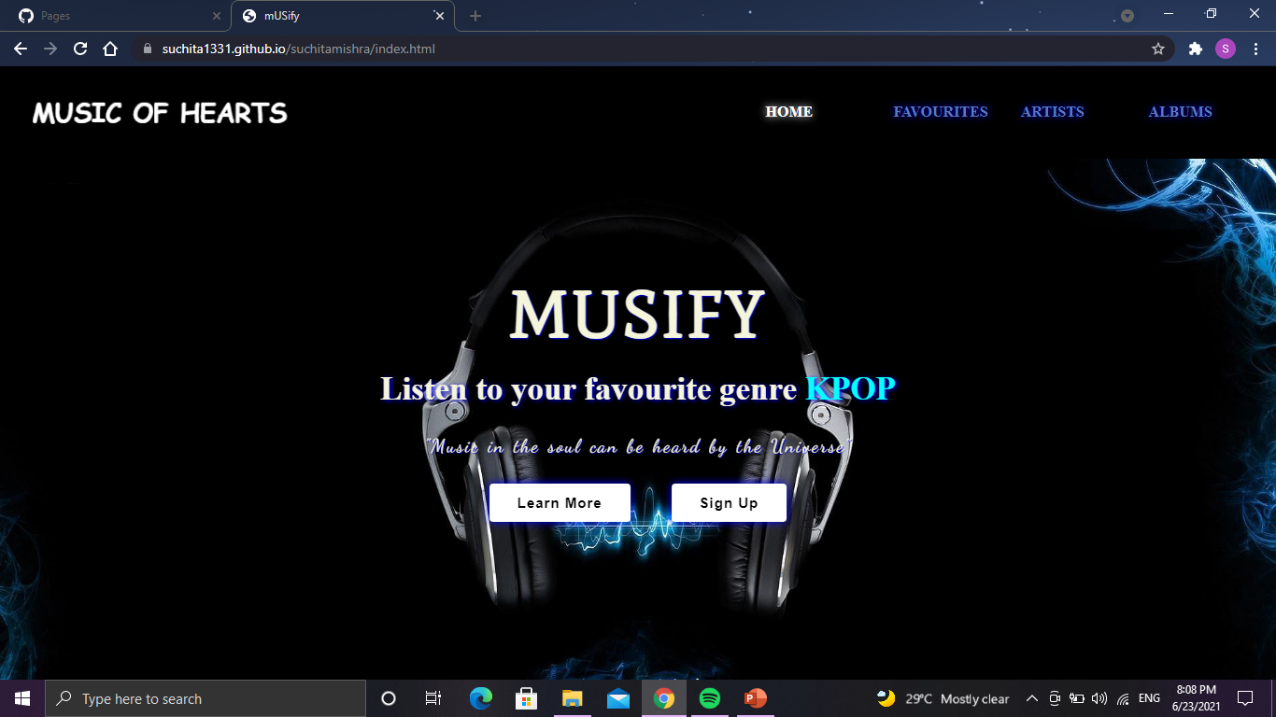
Screen Shots
Home
S. B. Jain Institute of Technology Management and Research
10

Slide 11
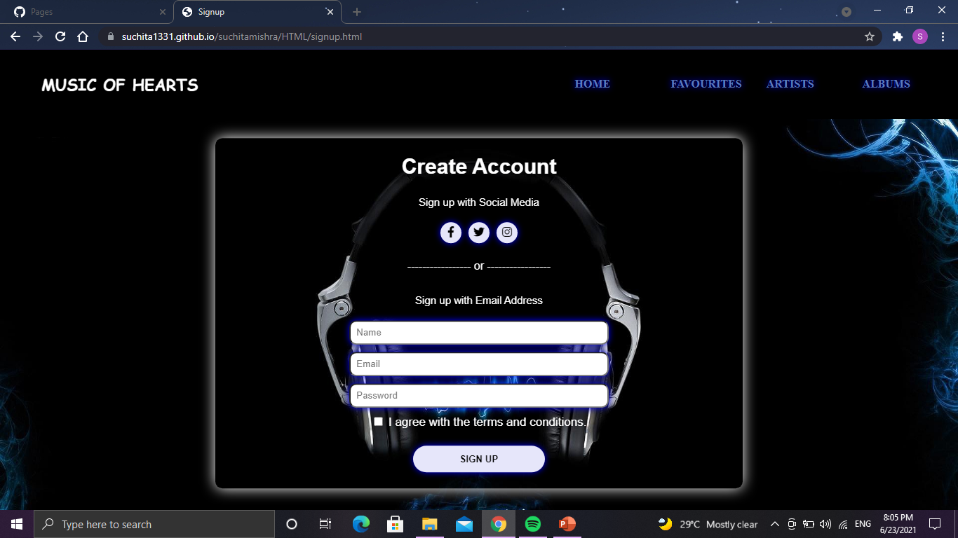
Sign Up
S. B. Jain Institute of Technology Management and Research
11

Slide 12
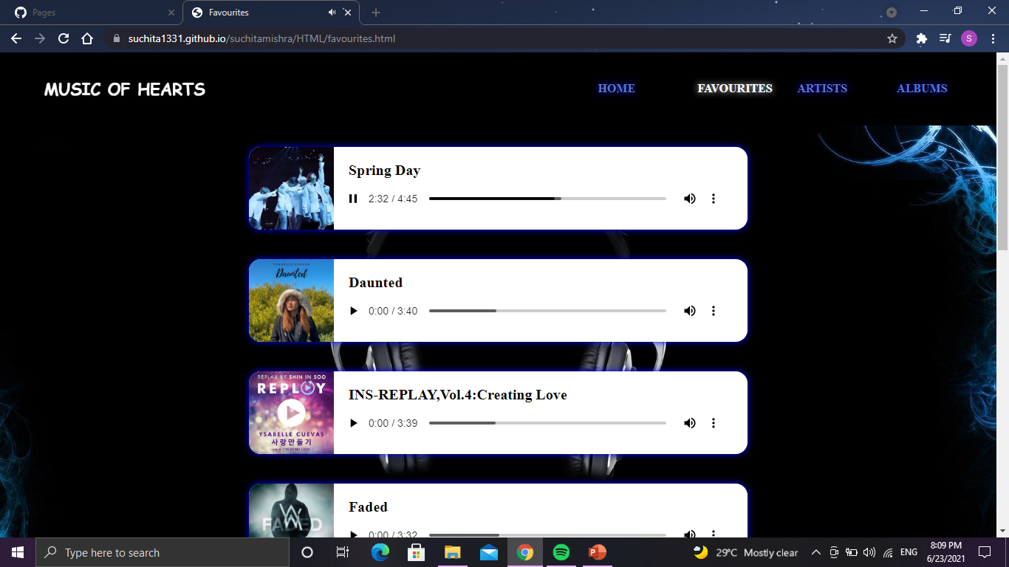
Favourites
S. B. Jain Institute of Technology Management and Research
12

Slide 13
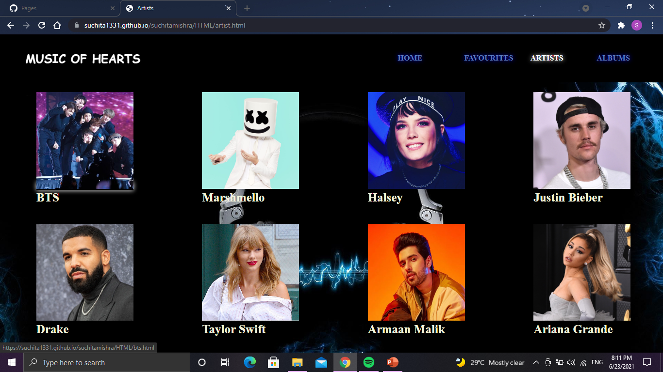
Artists
S. B. Jain Institute of Technology Management and Research
13

Slide 14
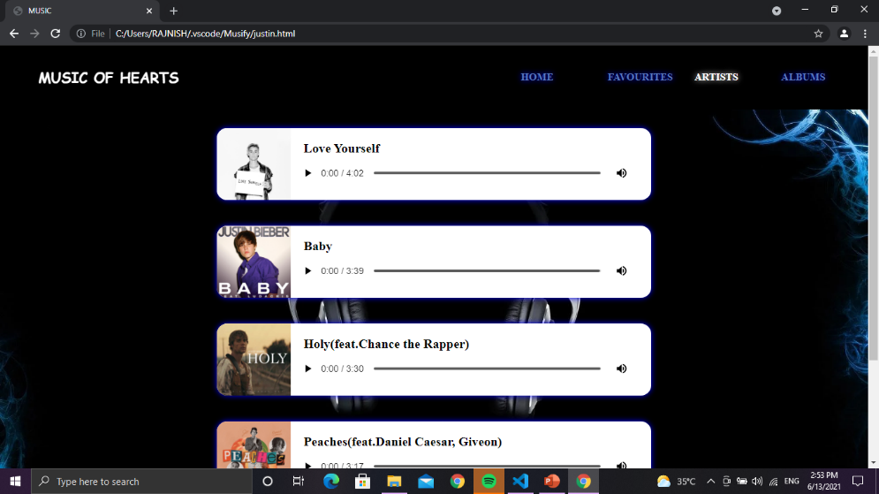
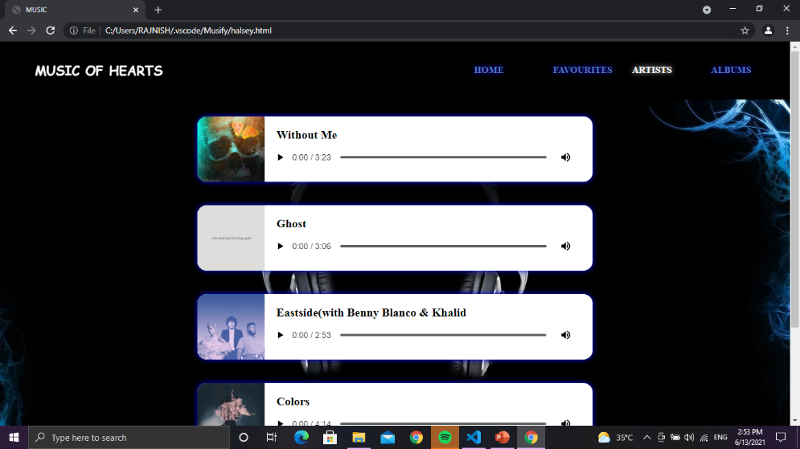
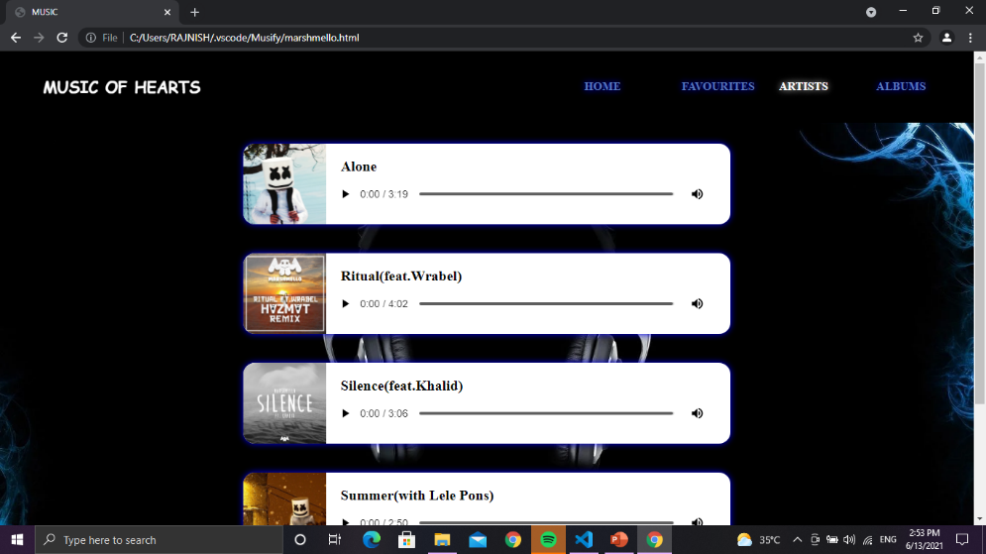
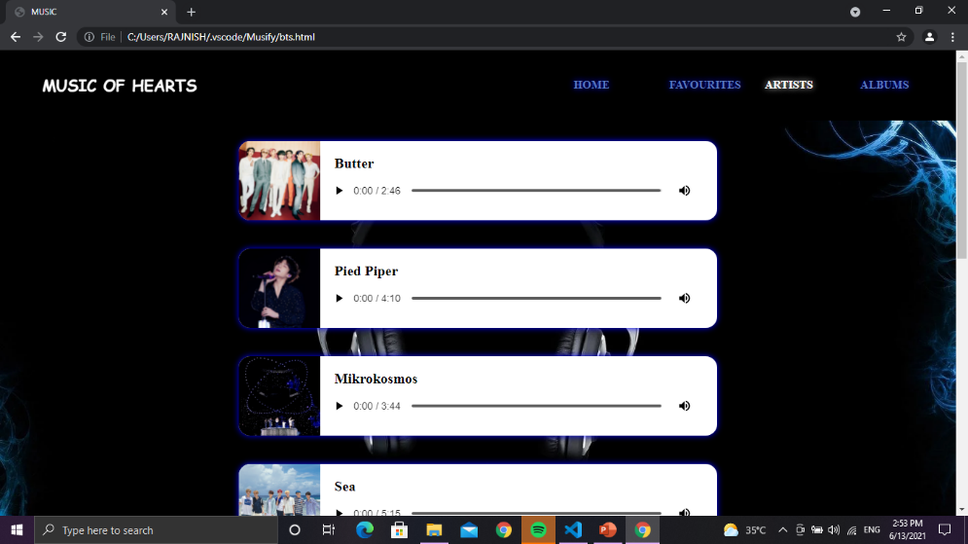
S. B. Jain Institute of Technology Management and Research
14

Slide 15
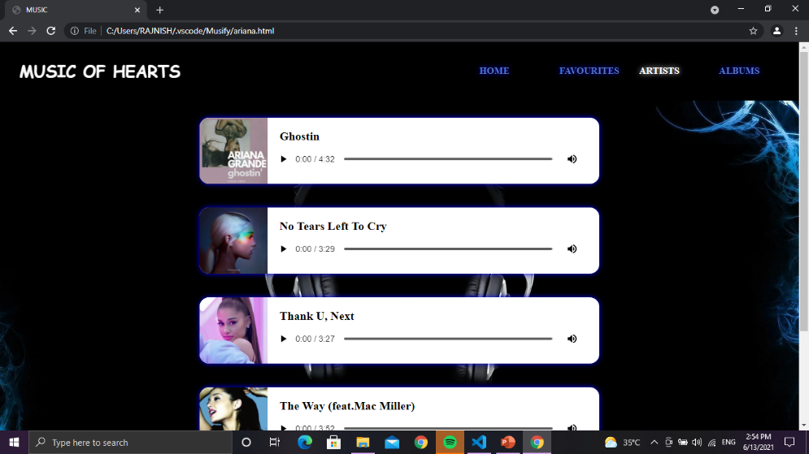
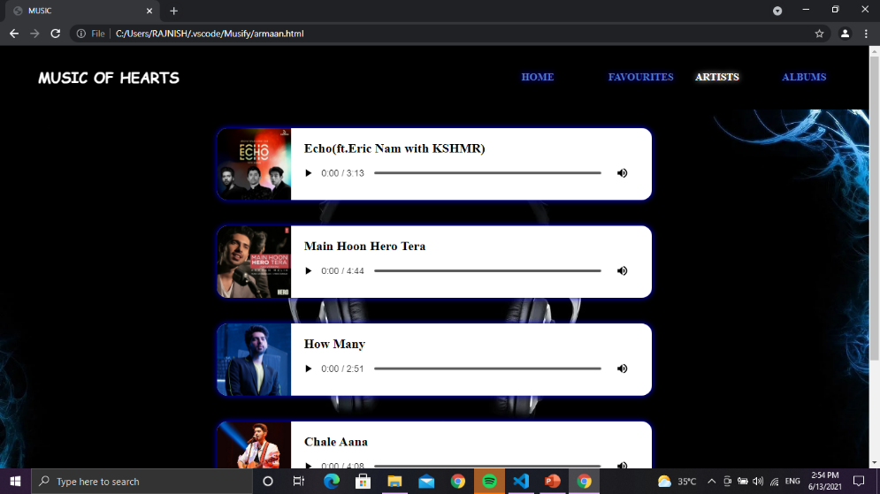
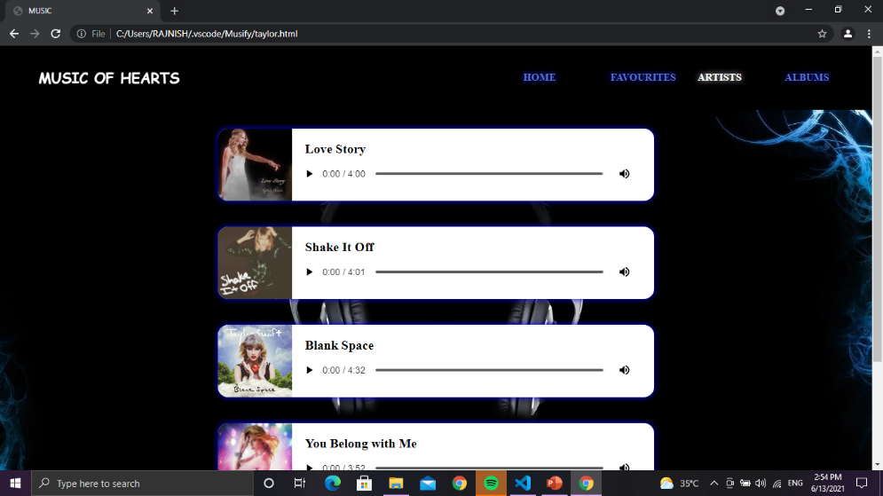
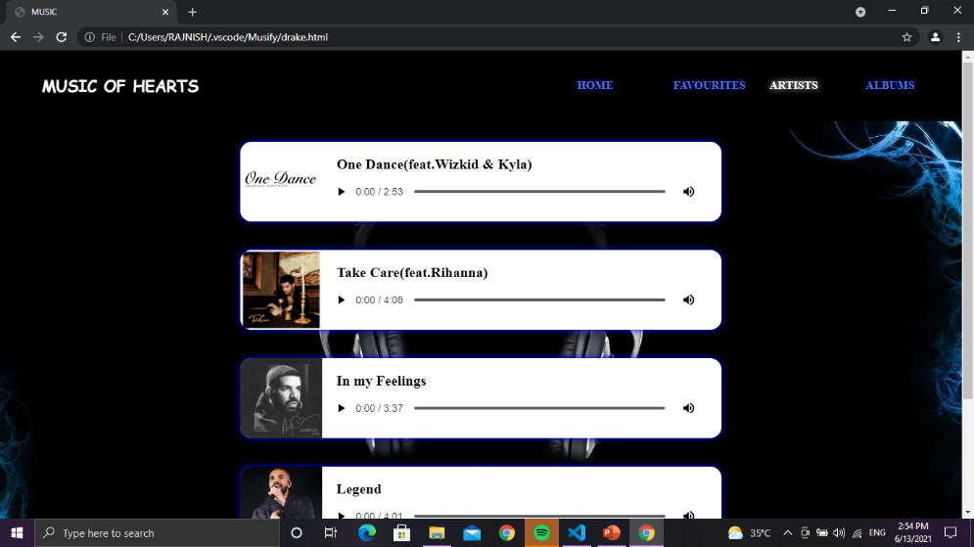
S. B. Jain Institute of Technology Management and Research
15

Slide 16
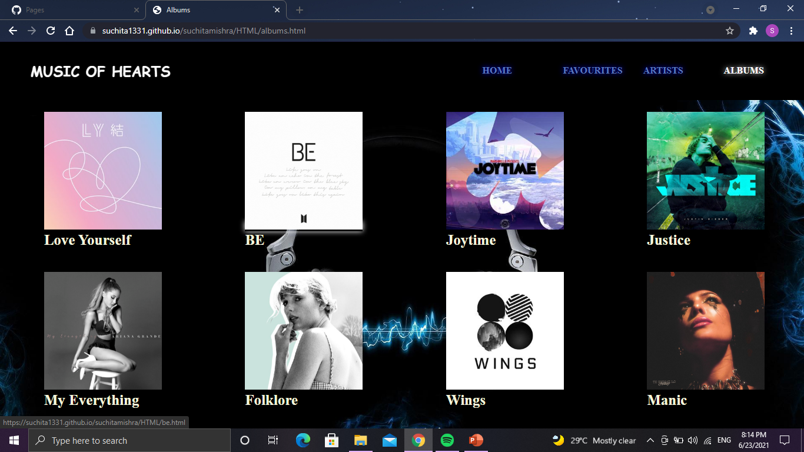
Albums
S. B. Jain Institute of Technology Management and Research
16

Slide 17
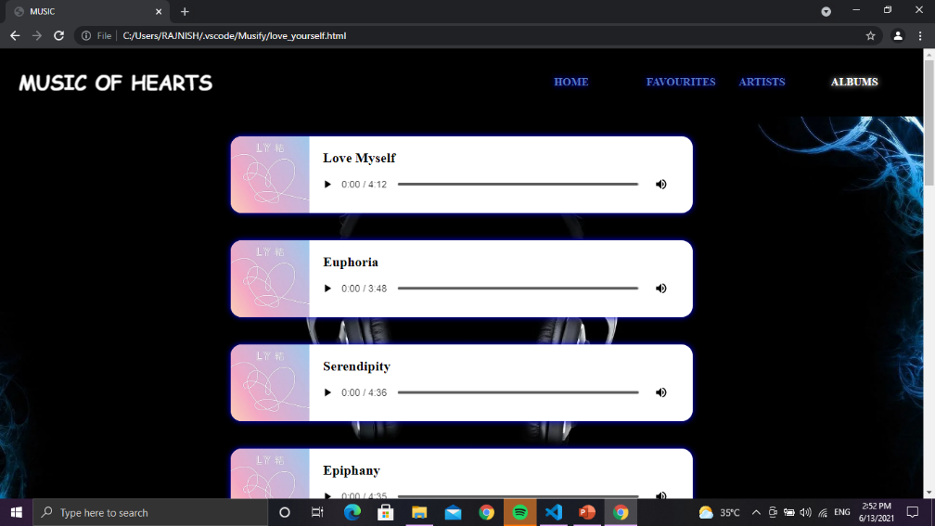
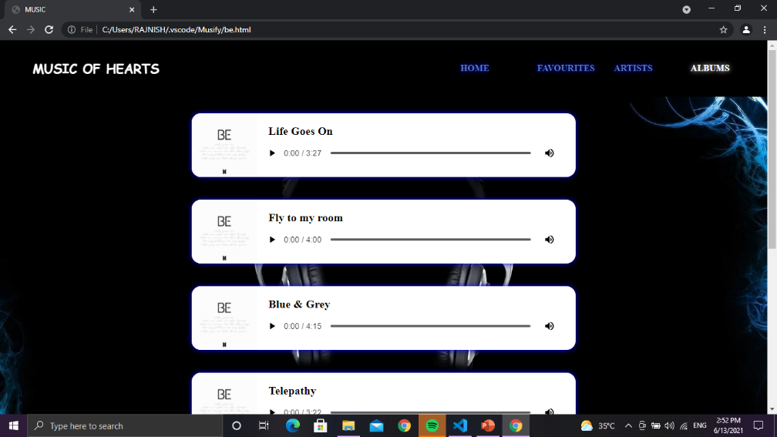
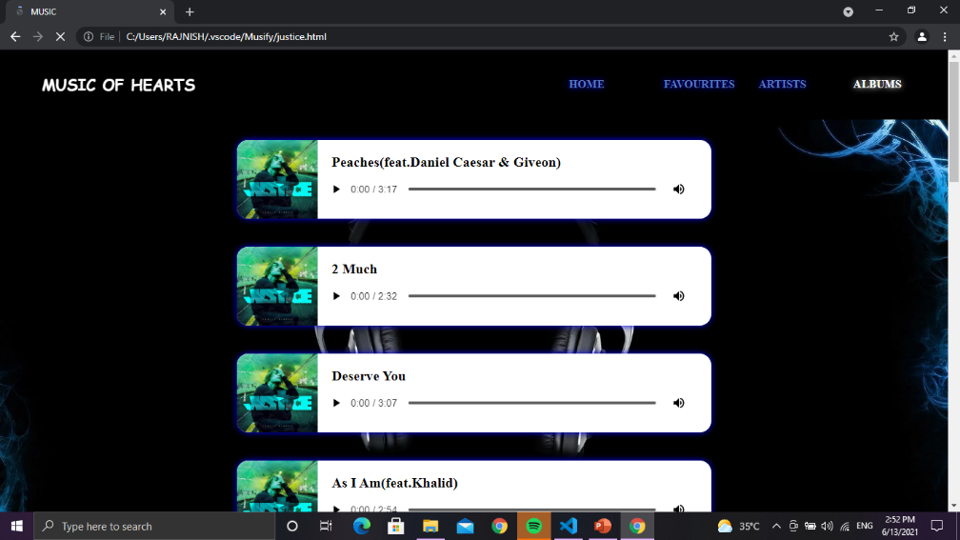
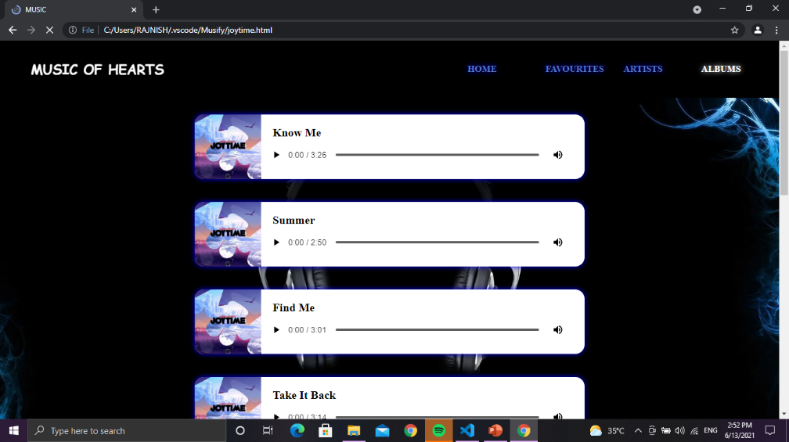
S. B. Jain Institute of Technology Management and Research
17

Slide 18
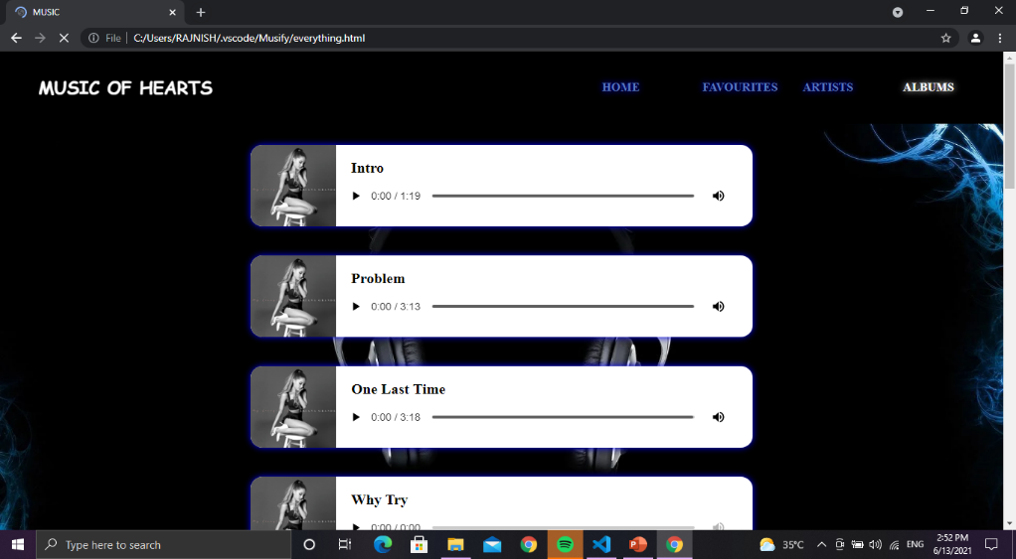
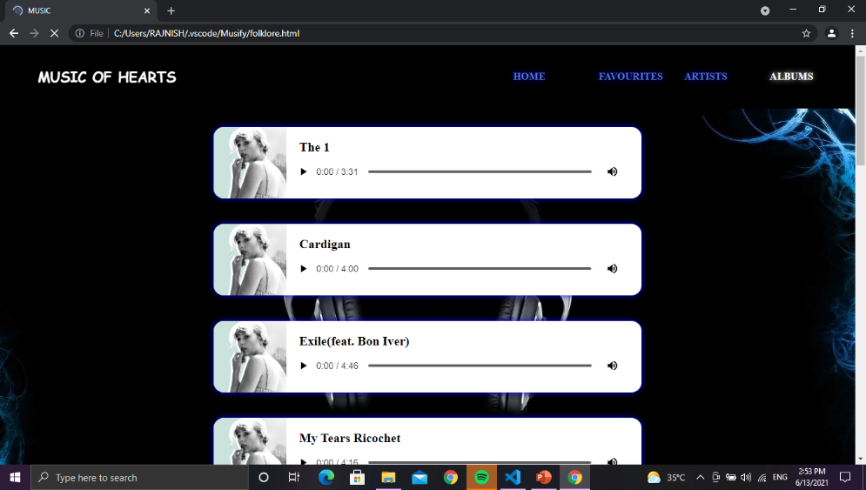
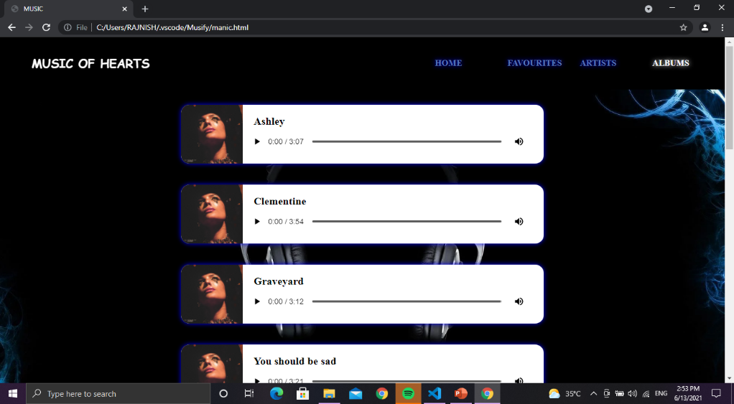
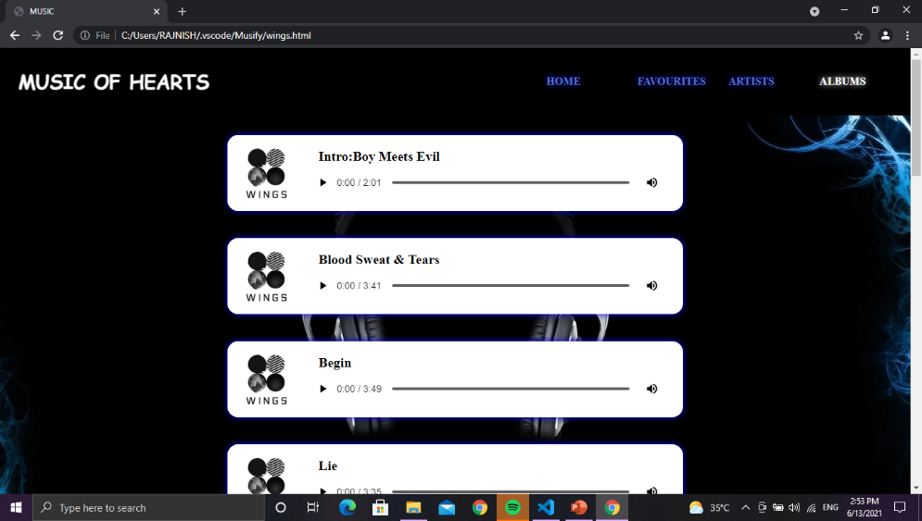
S. B. Jain Institute of Technology Management and Research
18

Slide 19
Advantages & Applications
Advantages :-
Accessibility
Variety & Choice
Own playlists
Relaxation
Applications :-
To provide music of their choice to the users.
S. B. Jain Institute of Technology Management and Research
19

Slide 20
References
Websites:
www.w3schools.com
www.youtube.com
S. B. Jain Institute of Technology Management and Research
20

Slide 21
Thank You

